Slide 1
Internet of Things essentials presentation
FIRE AND SMOKE DETECTION AND ALERTING SYSTEM USING GSM
UKESHWARAN S (210701295)
VISHWA N (210701315)
AYYAPPAN A (210701510)

Slide 2
AGENDA
I. ABSTRACT
II. INTRODUCTION
III. OBJECTIVE
IV. LITERATURE SURVEY
a. KEY CHALLENGES
b. MOTIVATION
V. EXISTING SYSTEM
VI. PROPOSED SYSTEM
VII.MODULES
VIII. SYSTEM ARCHITECTURE
IX. CONCLUSION AND FUTURE ENHANCEMENTS
X. REFERENCES

Slide 3
ABSTRACT
In this project, we present a Fire Alarm System implemented using Arduino microcontroller. The system employs temperature and smoke sensors to detect potential fire hazards. Upon detection, the Arduino triggers an alarm and activates a notification system, which can include SMS alerts or email notifications. Additionally, real-time data monitoring is facilitated through a graphical user interface (I2C Display) on a computer or mobile device, providing remote access and control. The system offers a cost-effective and reliable solution for fire detection and prevention in various environments, ensuring timely response to emergencies.

Slide 4
INTRODUCTION
The emergence of Arduino microcontrollers has revolutionized the field of DIY electronics, enabling enthusiasts to create sophisticated yet affordable solutions for a variety of real-world problems. In this context, we introduce a Fire Alarm System developed using Arduino technology. This project addresses the critical need for early fire detection and prevention in both residential and commercial settings. By integrating temperature and smoke sensors with Arduino, our system offers a robust and customizable solution for detecting potential fire hazards. Through this introduction, we aim to highlight the significance of our project in enhancing fire safety measures and mitigating risks in diverse environments.

Slide 5
OBJECTIVE
⠂Develop a Reliable Fire Detection System: Design and implement a fire alarm system using Arduino that reliably detects fire and smoke presence to ensure early fire detection.
⠂Integrate Sensor Technology: Incorporate temperature and smoke sensors into the Arduino-based system to accurately monitor environmental conditions and identify potential fire hazards.
⠂Implement Alarm and Notification Mechanisms: Program the Arduino to trigger audible and visual alarms upon detecting signs of fire, while also integrating notification mechanisms such as SMS alerts or email notifications to alert users remotely.
⠂Ensure Cost-Effective and Scalable Solution: Develop a cost-effective solution that utilizes readily available components and can be easily scaled to meet the needs of various environments, ranging from homes to commercial buildings, without compromising reliability or functionality.

Slide 6
LITERATURE SURVEY
S.NO | AUTHOR(S) | YEAR OF PUBLISHING | TITLE | DESCRIPTION
1. | Suardi, J | 2021 | Design of a Home Fire Detection System Using Arduino and SMS Gateway. | This paper describes a fire detection system that uses Arduino to monitor temperature and gas levels, triggering alarms and sending SMS alerts when thresholds are exceeded​​.
2. | Pacheco, J | 2022 | Arduino-Based Fire Alarm System with GSM Module. | The study presents a GSM-based fire alarm system that detects flames and sends SMS alerts. It includes code and circuit diagrams for practical implementation​​.

Slide 7
LITERATURE SURVEY
3. | Jakubowski K | 2020 | Analysis of Reliability Requirements for Fire Alarm Systems Operated in Civil Structures. | This paper analyzes the reliability requirements for fire alarm systems in critical infrastructure and civil structures, emphasizing the importance of continuous performance during emergencies​​.
4. | Zhou, K., Zhang, X. | 2020 | Design of Outdoor Fire Intelligent Alarm System Based on Image Recognition. | The research focuses on an outdoor fire detection system using neural networks to reduce false alarms and improve detection accuracy in varied environments​​.

Slide 8
LITERATURE SURVEY
5. | Goswami L | 2021 | Developing a Voice-Directed Fire Alarm System Using Arduino Microcontroller. | This paper explores a voice-directed fire alarm system that uses Arduino to enhance communication during fire emergencies, improving response times and clarity​​.
6. | Singh, D | 2020 | Cloud Computing: Analysis of Top 5 CSPs in SaaS, PaaS and IaaS Platforms Although focused on cloud computing. | This paper discusses integrating cloud services with fire alarm systems to enhance data storage and real-time monitoring capabilities​​.

Slide 9
LITERATURE SURVEY
7. | Solanki M.S | 2020 | Automatic Detection of Temples in Consumer Images Using Histogram of Gradient. | This study, while not directly about fire alarms, provides relevant insights into image processing techniques that can be applied to fire detection systems​​.
8. | Wu, Q., et al | 2021 | Intelligent Smoke Alarm System with Wireless Sensor Network Using ZigBee. | The paper discusses a smoke alarm system using Arduino and ZigBee for wireless communication, allowing for scalable and flexible installations​​.

Slide 10
LITERATURE SURVEY
9. | Jagtap, M.T | 2020 | Depth Accuracy Determination in 3D Stereoscopic Image Retargeting Using DMA, | This research provides methodologies for 3D image processing that can enhance fire detection systems using stereoscopic image technology​​.
10. | Bala, L , Vatsa, K | 2021 | Quality Based Bottom-up Detection and Prevention Techniques for DDoS in MANET | While focusing on network security, the techniques discussed for detecting and preventing DDoS attacks can be adapted to improve the security and robustness of IoT-based fire alarm systems​​.

Slide 11
KEY CHALLENGES
1. Sensor Accuracy
Ensuring accurate detection and avoiding false alarms.
Regular calibration and high-quality sensors.
2. Power Reliability
Consistent power during emergencies.
Backup sources like batteries.
3.Real-time Processing
Quick sensor data processing to trigger alarms.
Optimized Arduino code.
4.Environmental Factors
Preventing dust, humidity, and pollutants interference.
Proper sensor housing and maintenance.

Slide 12
KEY CHALLENGES
5.Communication and Alerts
Loud alarms and sending alerts to emergency services.
Reliable communication modules (GSM, Wi-Fi).
6.Scalability
Covering larger areas and multiple zones.
Modular design for expansion.
7.Cost
Balancing cost and reliability.
Cost-effective, reliable components.
8.Compliance
Meeting fire safety regulations.
Adhering to standards.

Slide 13
MOTIVATION
Developing a fire alarm system using an Arduino Uno is a rewarding project that combines electronics, programming, and safety engineering.
The motivation behind this project is the critical need to enhance fire safety in homes and buildings.
Fires can cause devastating loss of life and property, and a reliable, cost-effective fire alarm system can make a significant difference in early detection and response.
By leveraging the versatile Arduino platform, this project offers a practical solution to a vital safety concern and an educational opportunity in sensor integration and real-time data processing, empowering individuals to safeguard their environments and potentially save lives.

Slide 14
EXISTING SYSTEM
Existing Arduino-based fire alarm systems utilize various sensors and communication modules to detect fires and send alerts. Basic systems typically use smoke sensors like the MQ-2 along with buzzers to provide immediate audible alarms. More advanced setups integrate GSM modules to send SMS alerts or use Wi-Fi modules such as the ESP8266 for IoT-enabled solutions, offering real-time monitoring and notifications through cloud services.
Some systems incorporate voice recognition modules to deliver verbal evacuation instructions, enhancing emergency communication. Additionally, multi-sensor configurations combine smoke, flame, and temperature sensors with displays for comprehensive monitoring and detailed alerts.

Slide 15
PROPOSED SOLUTION
The proposed system aims to enhance fire detection and alert mechanisms by integrating advanced features and improving existing functionalities. This system will employ a combination of sensors, including smoke, flame, and temperature sensors, to ensure accurate detection of various fire indicators. It will utilize a GSM module for SMS alerts and an ESP8266 Wi-Fi module to enable IoT capabilities, allowing for real-time data monitoring and notifications via cloud platforms.
The system will also include a voice recognition module for delivering clear verbal instructions during emergencies and an LCD display for real-time data visualization. The proposed system aims to improve reliability, accuracy, and response time, making it a more robust and user-friendly fire detection solution.

Slide 16
MODULES
1.Sensor Module
2.Microcontroller Module
3.Monitoring System Module
4.Alert System Module
5.GSM Module

Slide 17
1.Sensor Module:
Smoke sensor (MQ-2)
Flame sensor (LM35)
(i) Detect smoke and fire by sensing changes in
smoke and temperature.
(ii) Provide real-time data to the microcontroller.

Slide 18
2.Microcontroller Module
Microcontroller board (Arduino Uno)
(i) Read data from sensors.
(ii) Process the data to determine if there is a
fire or smoke.
(iii) Trigger alerts if the sensor readings exceed
predefined thresholds.
(iv) Communicate with the GSM module to send
alerts.

Slide 19
3.Monitoring System Module
Monitoring Display(I2c Display)
(i) I2c display shows the flame and smoke values
from microcontroller.
4.GSM Module
GSM module (SIM800L)
(i) Send SMS alerts to predefined phone numbers.
(ii) Enable remote monitoring of the system via
SMS.

Slide 20
5.Alert System Module:
Buzzer
LEDs for visual indicators
(i) Provide immediate audio-visual alerts in case
of smoke or fire detection.
(ii) Work as a local alert mechanism in addition to
GSM-based remote alerts.

Slide 21
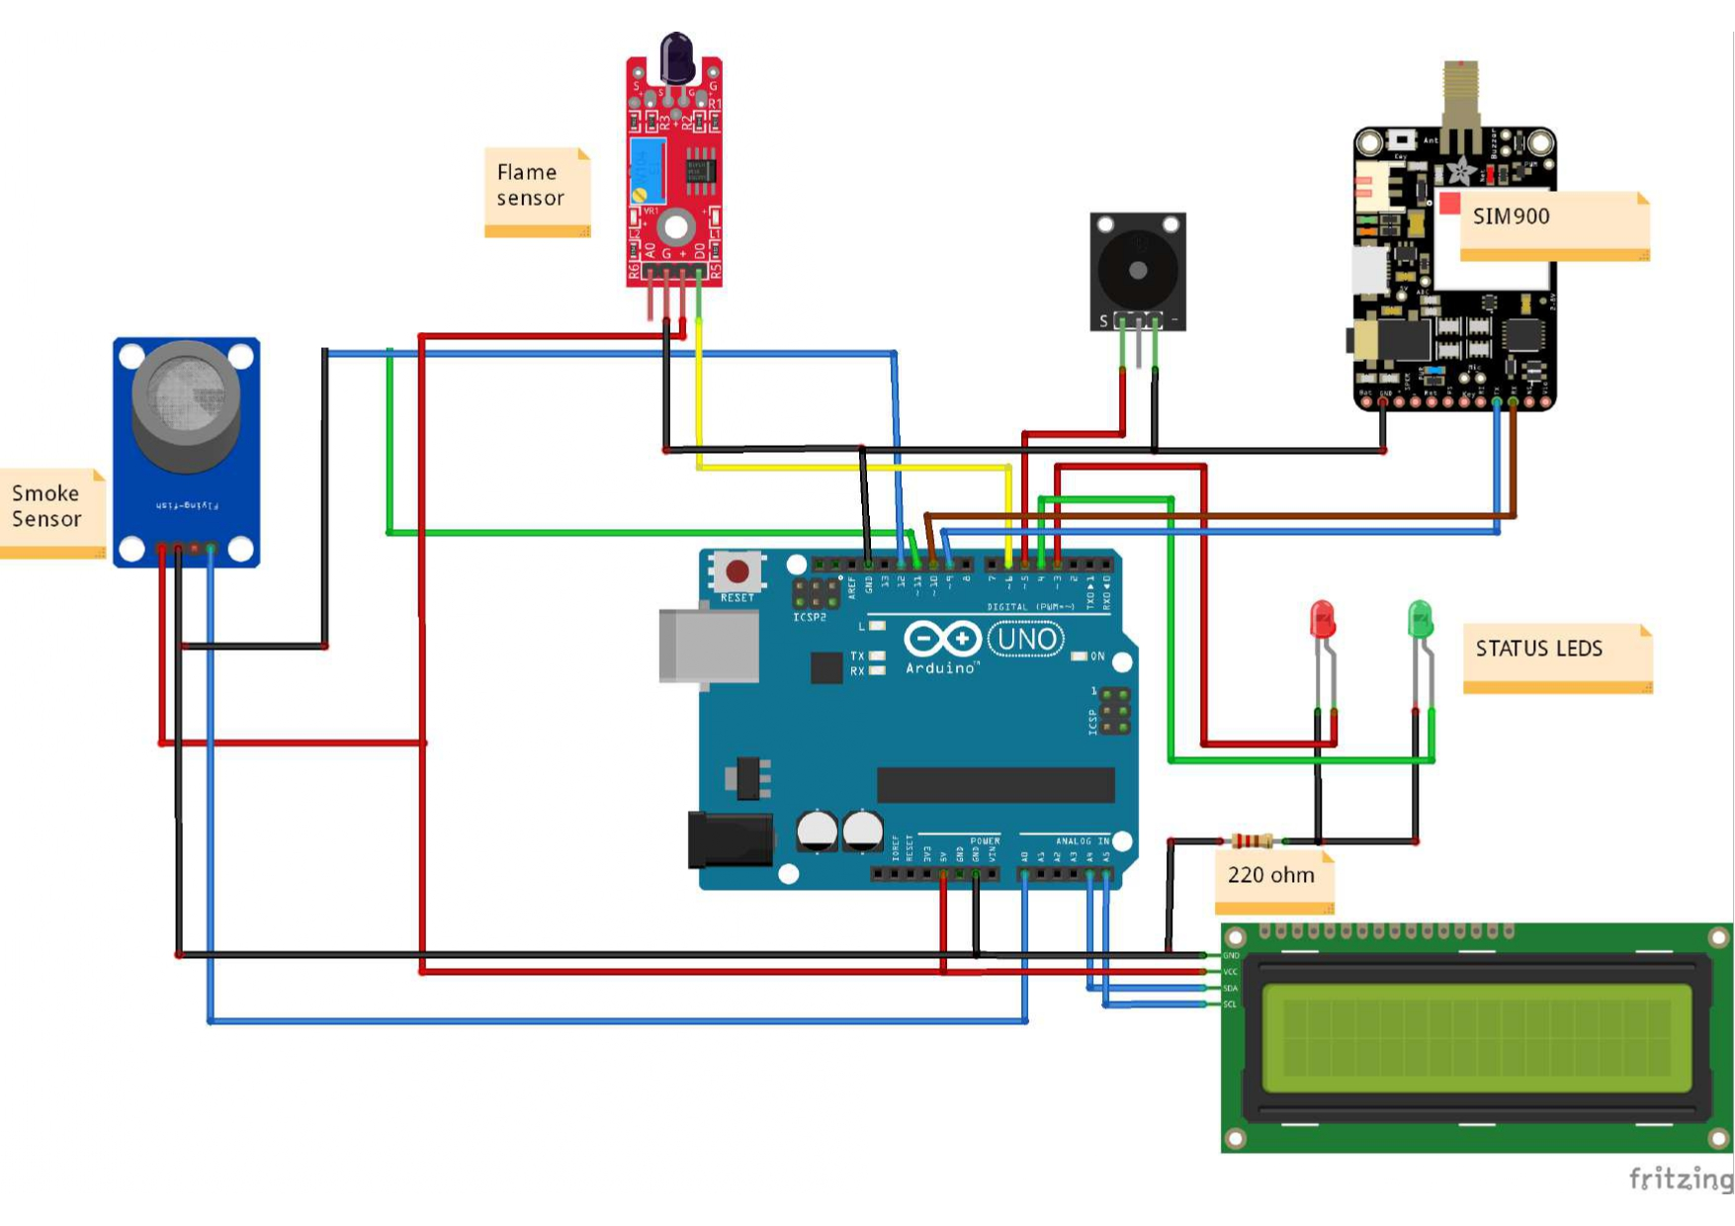
SYSTEM ARCHITECTURE

Slide 22
CONCLUSION
The proposed system aims to enhance fire detection and alert mechanisms by integrating advanced features and improving existing functionalities. This system will employ a combination of sensors, including smoke, flame, and temperature sensors, to ensure accurate detection of various fire indicators.
It will utilize a GSM module for SMS alerts and an ESP8266 Wi-Fi module to enable IoT capabilities, allowing for real-time data monitoring and notifications via cloud platforms. The system will also include a voice recognition module for delivering clear verbal instructions during emergencies and an LCD display for real-time data visualization. The proposed system aims to improve reliability, accuracy, and response time, making it a more robust and user-friendly fire detection solution.

Slide 23
FUTURE ENHANCEMENTS
Machine Learning Integration: Implementing machine learning algorithms can improve the accuracy of fire detection by analyzing patterns and reducing false alarms.
Enhanced IoT Connectivity: Expanding IoT capabilities to include integration with smart home systems and broader network protocols (e.g., Zigbee, LoRaWAN) can provide more robust and scalable solutions.
Energy Efficiency: Developing low-power designs and incorporating renewable energy sources like solar panels can make these systems more sustainable and suitable for remote locations.
User Interface Improvements: Enhancing the user interface with mobile apps and web dashboards can provide users with more intuitive and comprehensive control and monitoring options.

Slide 24
REFERENCES
[1] "IoT-Based Smart Fire Safety System" by P. P. Sharma, N. Singh, and V. Singh, IEEE Sensors Journal, 2020.
[2]"Development of an IoT-Based Smoke and Fire Detection System for Smart Home" by A. S. Salma, M. K. Hasan, and R. Ahmed, International Journal of Electrical and Computer Engineering, 2020.
[3]"Advanced IoT-based Wireless Communication Systems for Indoor Fire Detection" by Jiannong Cao and Yunchuan Sun "Fire Detection Using IoT and Image Processing Techniques" by M. Kumar, S. Sharma, and R. Gupta, Journal of Ambient Intelligence and Humanized Computing, 2022.
[4]"Advanced IoT-based Wireless Communication Systems for Indoor Fire Detection" by Jiannong Cao and Yunchuan Sun "Fire Detection Using IoT and Image Processing Techniques" by M. Kumar, S. Sharma, and R. Gupta, Journal of Ambient Intelligence and Humanized Computing, 2022.
[5] "A Wireless IoT System Towards Gases and Particles Monitoring for Industrial Safety Applications" by P. N. Murgatroyd and T. K. Atkinson, IEEE Transactions on Industrial Informatics, 2019.

